Slide 1
Healthcare Information and Management Systems Society Blockchain in Healthcare Task Force Lightning Round Presentation

Slide 2
Agenda: 1. ACT-IAC Emerging Technology Community of Interest, AI and Blockchain Working Groups 2. ACT-IAC National Use Case and Solutions Library a. Whitepaper and Pilot Platform b. ET Use Case Summit 3. National Artificial Intelligence Institute a. AI@VA Community b. Tech Sprints c. BRAIN Summit

Slide 3
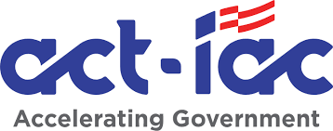
Emerging Technology Community of Interest

Slide 4
Public Private Partnership Collaboration
Emerging Technology Community of Interest (COI)
Mission: Provide an energetic, collaborative consortium comprised of leading practitioners in data science, technology, and research, engaged with industry, academia, and public officials and executives focused on emerging and leading technologies which transform public sector capabilities.
Seven working groups: Blockchain, Artificial Intelligence (AI), Intelligent Automation (IA), Internet of Things (IoT), DevSecOps, Quantum Computing, and the National Use Case and Solutions Library (NUCSL)
AI
Emerging Technology Accelerator
IoT
IA
Emerging Technology COI
Quantum
Future of Work
Transformation
Security and Data
Blockchain
DevSecOps
NUCSL

Slide 5



Public Private Partnership Collaboration
Blockchain and Artificial Intelligence Working Groups
White Papers
Primer
Playbook
Safety, Privacy, Security
Blockchain Working Group Projects
AI
Blockchains, Directed Acyclic Graphs, and More
Public and Private Distributed Ledgers
Consensus Mechanisms
Smart Contracts
Governance
Digital Assets
Web3 and Decentralization
Use Cases for Federal Government
Use Cases for State and Local
Risks and Limitations
IoT
IA
Primer
Emerging Technology COI
NUCSL
Quantum
Blockchain
1
Problem Assessment
2
Organizational Readiness
DevSecOps
3
Solution Selection
4
Blockchain Implementation
Playbook

Slide 6
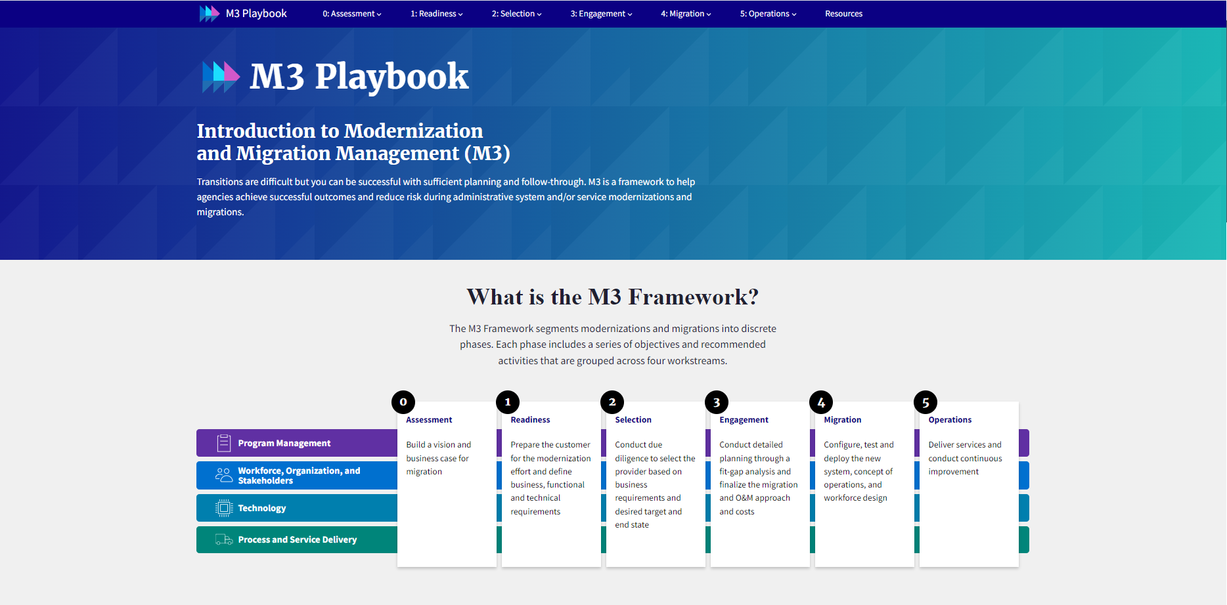

Slide 7
NATIONAL USE CASE AND SOLUTIONS LIBRARY

Slide 8

What is a NUCSL?
1
A National Use Case and Solutions Library (NUCSL), is an online national use case library.
2
A NUCSL provides a common place where stakeholders can share, search, and learn about emerging technologies across the Federal government, saving time, resources, and funding.

Slide 9
NUCSL White Paper and Pilot Platform
Focuses on policy considerations
Provides four key recommendations:
Federal Acquisition Regulation (FAR) Part 7.
Chief Technology Officer Appointment.
Successful Use Cases.
Agency(ies) Sponsor.
White Paper
Identifies use case representatives
Tracks use cases through their full lifecycle
Incorporates the “As-Is/To-Be” Gap Analysis Methodology
Enables technology road mapping
Data Captured: Risk(s), Rationale, Constraints, Transformation Enablers, Stakeholders, Business Process Model, Organizational Readiness, Technology Selection, Lessons Learned
Pilot Platform

Slide 10

Benefits of a NUCSL
1
Decreasing the lag time between procuring and implementing emerging technologies by simplifying and accelerating the acquisition lifecycle.
4
Increasing awareness around policy, regulatory, and legislative requirements for emerging technologies especially regarding security.
2
Ensuring emerging technology use cases and recommendations are stored and maintained in a single use case library which is publicly accessible.
5
Incentivizing the emerging technology community to submit use cases to a NUCSL.
Encouraging the emerging technology stakeholder community to share information around challenges, risks, successes, best practices, and lessons learned.
6
Supporting creative approaches for how agencies identify, select, procure, pilot, and implement emerging technologies based on their unique needs and mission objectives.
3

Slide 11
NUCSL Highlights
Quick Stats and Information Since Launching on February 22, 2022:
Number of people the NUCSL white paper has been shared with: 10,253+
Number of presentations conducted for the NUCSL: 14
Number of people the NUCSL customer journey maps have been shared with: 200+
NUCSL features and information users are most interested in: Emerging Technology Adoption Feasibility, Cross-Agency Collaboration, and Identifying Lessons Learned
Emerging Technology Use Case Organizations Represented in a NUCSL
Department of Homeland Security Procurement Innovation Lab
Internal Revenue Service
National Institute of Standards and Technology
Start-ups and Small, Medium, and Large Businesses
What’s Next!
Artificial Intelligence use case collection in alignment with Executive Order 13960
Incubator, Chief Technology Officer, and Chief Data Officer outreach campaigns

Slide 12
Emerging Technology Use Case Summit September 20, 2022, from 9 AM to 11:30 AM In-Person (Location TBD)
Feature Your Use Case
Hear From Experts
Agenda
9:00 AM – 9:15 AM
Keynote
9:20 AM – 9:45 AM
Panel Discussion
10:00 AM – 10:45 AM
Use Case Presentations
10:45 AM – 10:55 AM
Closing Remarks
11:00 AM – 11:30 AM Emerging Technology Use Case Showcase
1
Between July 20th and August 30th, submit your use case to ACT-IAC’s National Use Case and Solutions Library.
Technology leaders in government, industry, and academia will present on use cases covering technologies such as artificial intelligence, machine learning, blockchain, and more
Panelists from across government will join us to discuss how agencies are gathering and sharing emerging technology use cases within their organizations and across government
Government and industry organizations will showcase use cases featured in ACT-IAC’s National Use Case and Solutions Library
2
Once your use case has been submitted, it will be featured on ACT-IAC’s Emerging Technology Community of Interest LinkedIn page.
3
Organizations who submit use cases between July 20th and August 30th will be invited to showcase their use cases at the Emerging Technology Use Case Summit.

Slide 13
Presentation Links
Blockchain Playbook
Artificial Intelligence Primer
Artificial Intelligence Playbook
NUCSL White Paper
NUCSL Pilot Platform
Use Case Summit Registration
ACT-IAC Emerging Technology COI
ACT-IAC C-SCRM Shark Tank Materials and Video

Slide 14
National Artificial Intelligence Institute (NAII)

Slide 15
National Artificial Intelligence Institute
Vision
To lead the way in trustworthy artificial intelligence as a premier global institute for research, implementation, policy, and collaboration that enhances outcomes for our Veterans, their families, and beyond.
Mission
The National Artificial Intelligence Institute seeks to establish the U.S. Department of Veterans Affairs as the preeminent organization for research, development, and training of artificial intelligence with impact on a global scale, ensuring the health and well-being of our Veterans.

Slide 16



Role of the NAII
Identify New
Technology
Pilot Technologies with the Highest Potential
Provide AI Subject Matter Expertise

Slide 17

Building the AI Network
Across VA medical/centers, with academic affiliates, and external partners
Developing network and governance structures in collaboration with Data Governance Council
Subgroups with particular specialty areas and emphasis
Precision Oncology, Computer Vision, Diagnostic AI, Trustworthy AI, AI Ethics, Use Case Development
R&D with eye toward piloting

Slide 18

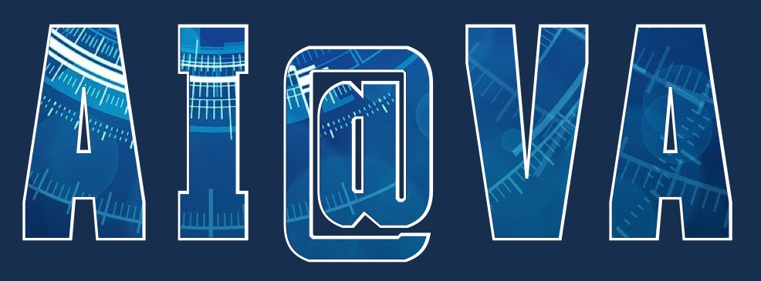
Community
Over 500 unique VA employee members and over 300 industry, government, and academia mailing list members
AI@VA Community SharePoint and MS Teams group for VA employee members
SME led interest groups with curated content and resources
Current AI news and research, updated daily
Learning Resource Hub with new resources added regularly
Monthly Lunch and Learn series with leading SMEs
Messaging reach of over 25k+ VA employees

Slide 19
AI Tech Sprints

Slide 20
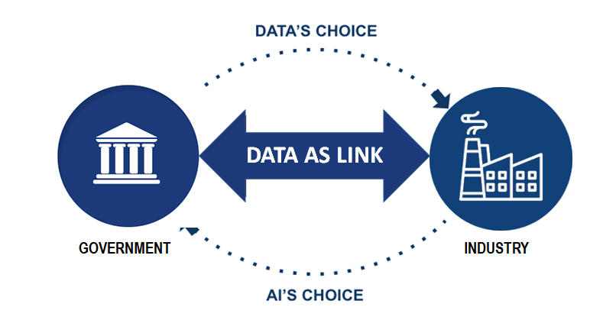
The AI Tech Sprint
We use data as a bidirectional link between government and users of that data across industry, government labs, and others.
Large, unique data sources (on clinical trials, patents, experimental therapeutics, patients)
Veteran and Expert perspectives
Technical expertise and user-based feedback
Demo and funding opportunities
Innovative product ideas
Technical AI/ML expertise
Trusted AI solution development through collaboration
Product development expertise

Slide 21




Recently Concluded— AITS: Veterans Not Currently Served
CONCEPT
PARTNERSHIP
ACCESS TO DATA
RESULTS
Invite teams to produce AI tools for “veterans not currently served by the VA”
60 applicants from industry, academia, and other non-governmental organizations
Pair each team with a subject matter expert: VA clinicians and staff to guide the development
44 teams began this process with over 90% SME pairing
Teams combine private data sources with VA data and expertise in an AI-enabled tool
All teams have data access through the VA Open Data Portal
Proposals for potential pilot, development, or contract with VA
32 teams produced complete demos for this experience

Slide 22
BRAIN SUMMIT

Slide 23
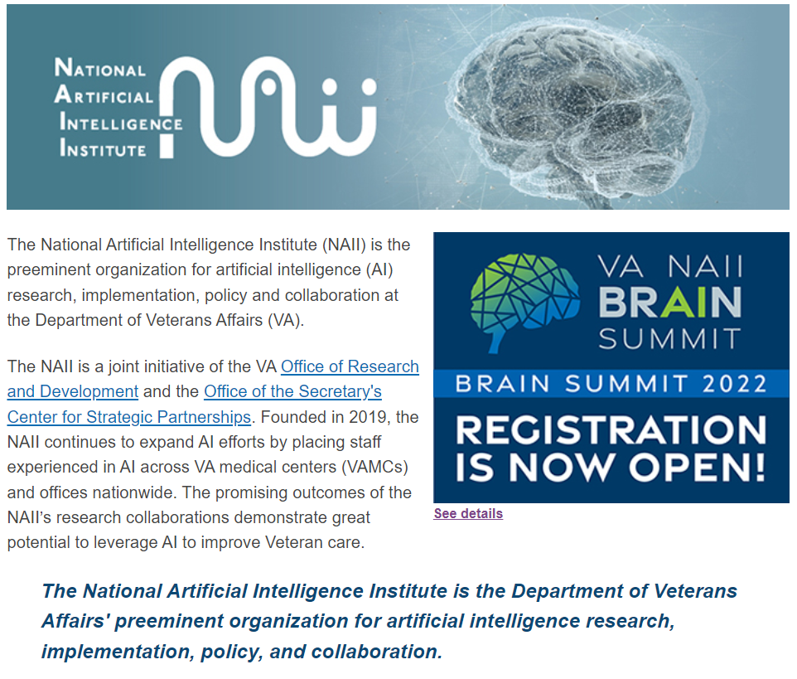

Slide 24
Thank you !

Slide 25

Questions?
Joshua A. Hakakian
Email: Joshua.Hakakian@va.gov
AI Inventory: VA AI Inventory
Website: National Artificial Intelligence Institute (NAII) (va.gov)
Sign up for AI@VA: Join the AI@VA Community

